Slide 1
Partial Fractions
Copyright © Cengage Learning. All rights reserved.

Slide 2
Partial Fraction Decomposition

Slide 3
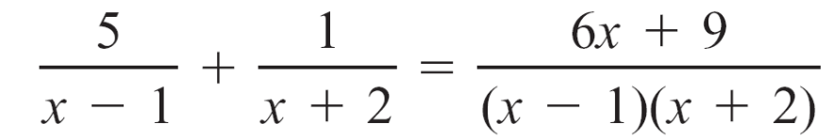
Partial Fraction Decomposition
An algebraic application of systems of equations is a technique known as partial fractions.
We have reviewed the problem of adding two rational expressions.
For example,
Now we will take the opposite approach.

Slide 4
Partial Fraction Decomposition
That is, given a rational expression, we will find simpler
rational expressions whose sum is the given expression.
The method by which a more complicated rational expression is written as a sum of simpler rational expressions is called partial fraction decomposition.
This technique is based on the following theorem.

Slide 5
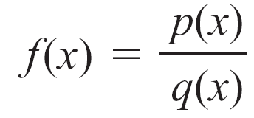
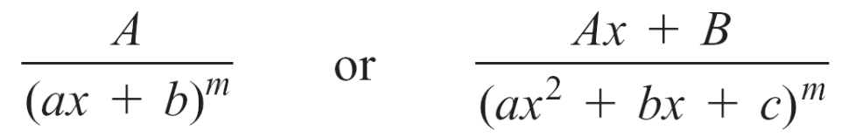
Partial Fraction Decomposition
Partial Fraction Decomposition Theorem
If
is a rational expression in which the degree of the numerator is less than the degree of the denominator, and p(x) and q(x) have no common factors, then f (x) can be written as a partial fraction decomposition in the form
f (x) = f₁(x) + f₂(x) + … + f_{n}(x)
where each f_{i}(x) has one of the following forms.

Slide 6

Partial Fraction Decomposition
The procedure for finding a partial fraction decomposition
of a rational expression depends on the factorization of the
denominator of the rational expression. There are four
cases.
Case 1 Nonrepeated Linear Factors
The partial fraction decomposition will contain an
expression of the form for each nonrepeated linear
factor of the denominator.

Slide 7
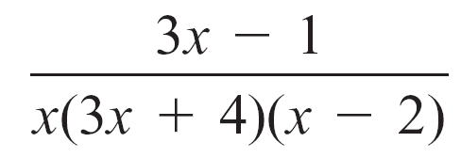
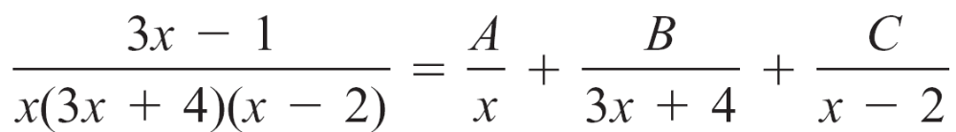
Partial Fraction Decomposition
For example, in the rational expression
each linear factor of the denominator occurs only once.
Thus its partial fraction decomposition has the form

Slide 8
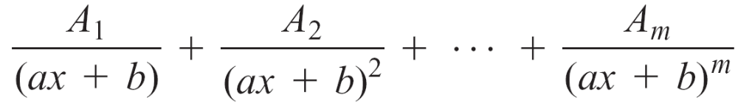
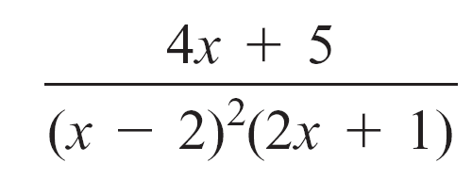
Partial Fraction Decomposition
Case 2 Repeated Linear Factors
The partial fraction decomposition will contain an expression of the form
for each repeated linear factor of multiplicity m.
For example, in the rational expression
the linear factor (x – 2) is a repeated linear factor.

Slide 9
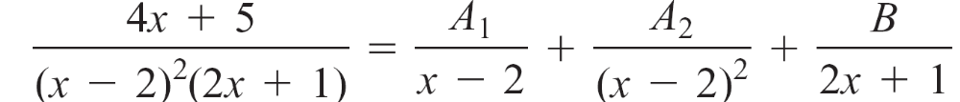
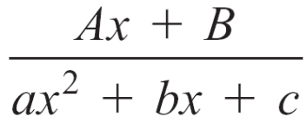
Partial Fraction Decomposition
Thus its partial fraction decomposition has the form
Case 3 Nonrepeated Quadratic Factors
The partial fraction decomposition will contain an expression of the form
for each quadratic factor that is irreducible over the real numbers.

Slide 10
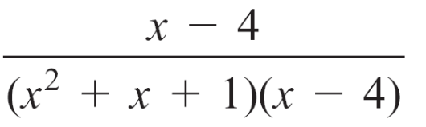
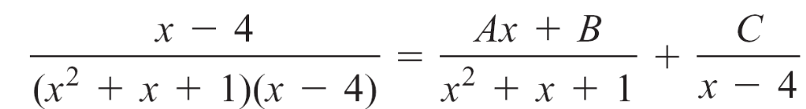
Partial Fraction Decomposition
For example, in the rational expression
the quadratic factor (x² + x + 1) is irreducible over the real numbers.
Thus its partial fraction decomposition has the form

Slide 11
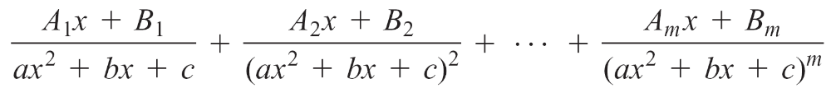
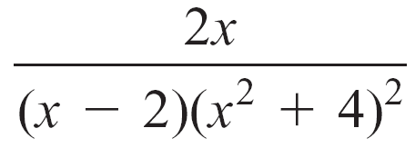
Partial Fraction Decomposition
Case 4 Repeated Quadratic Factors
The partial fraction decomposition will contain an expression of the form
for each quadratic factor that is irreducible over the real numbers.
For example, in the rational expression
(x² + 4) is a repeated quadratic factor.

Slide 12
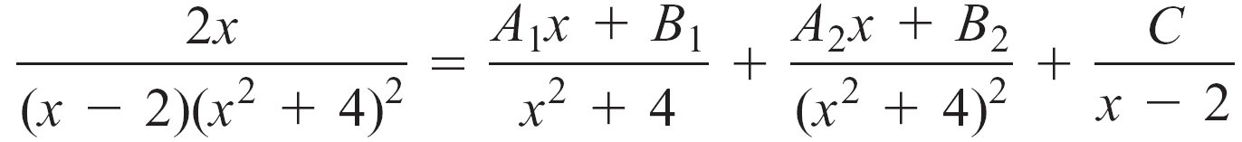
Partial Fraction Decomposition
Thus its partial fraction decomposition has the form
There are various methods for finding the constants of a partial fraction decomposition. One such method is based on a property of polynomials.

Slide 13
Partial Fraction Decomposition
Definition of Equality of Polynomials
If the two polynomials p(x) = a_{n}x^{n} + a_{n – 1}x^{n – 1} + … + a₁x + a₀
and r (x) = b_{n}x^{n} + b_{n – 1}x^{n – 1} + … + b₁x + b₀ are of degree n,
then p(x) = r (x) if and only if a₀ = b₀, a₁ = b₁, a₂ = b₂, . . . ,
a_{n} = b_{n}.

Slide 14
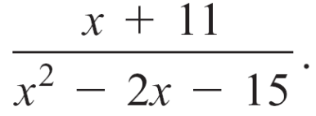
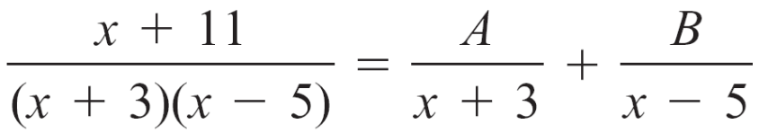
Example 1 – Find a Partial Fraction Decomposition Case 1: Nonrepeated Linear Factors
Find the partial fraction decomposition of
Solution:
First factor the denominator.
x² – 2x – 15 = (x + 3)(x – 5)
The factors are nonrepeated linear factors. Therefore, the partial fraction decomposition will have the form
(1)

Slide 15

Example 1 – Solution
cont’d
To solve for A and B, multiply each side of the equation by the least common denominator (LCD) of the denominators, (x + 3)(x – 5).
x + 11 = A(x – 5) + B(x + 3)
x + 11 = (A + B)x + (–5A + 3B)
Use the Definition of Equality of Polynomials to equate
coefficients of like powers.
The result will be the system of equations
1 = A + B
11 = –5A + 3B
Combine like terms.
Recall that x = 1  x.

Slide 16
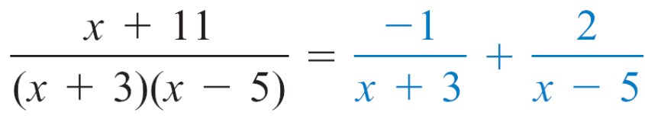
Example 1 – Solution
cont’d
Solving the system of equations for A and B, we have
A = –1 and B = 2.
Substituting –1 for A and 2 for B into the form of the partial fraction decomposition (1), we obtain
You should add the two expressions to verify the equality.

Slide 17
Partial Fraction Decomposition
The Partial Fraction Decomposition Theorem requires that
the degree of the numerator be less than the degree of the
denominator.
If this is not the case, use long division to first write the
rational expression as a polynomial plus a remainder over
the denominator.

